Slide 1
Small Investments in Early Learning = Big Returns in Social Emotional Development
Dr. Nicole Mortimer
Early Learning Coordinator
Anacortes School District

Slide 2
Overview of Session
What does Social Emotional Learning look like for Early Learners?
What impacts SEL for EL?
Supportive Networks
Specific Programs, Practice, and Partners
Now You Try!
Best Bang for Your Buck

Slide 3
WaKiDS: Washington Kindergarten Inventory of Developing Skills (3 of 6 Domains)
Social-Emotional
Cognitive (partial)
Language (partial)
-Regulates own emotions and behaviors
-Establishes and sustains positive relationships
-Participates cooperatively and constructively in group situations
-Demonstrates positive approaches to learning (attends, engages, persists, solves problems
-Remembers and connects experiences
-Listens to and understands increasingly complex language
-Uses language to express thoughts and needs
-Uses appropriate conversational and other communication skills

Slide 4
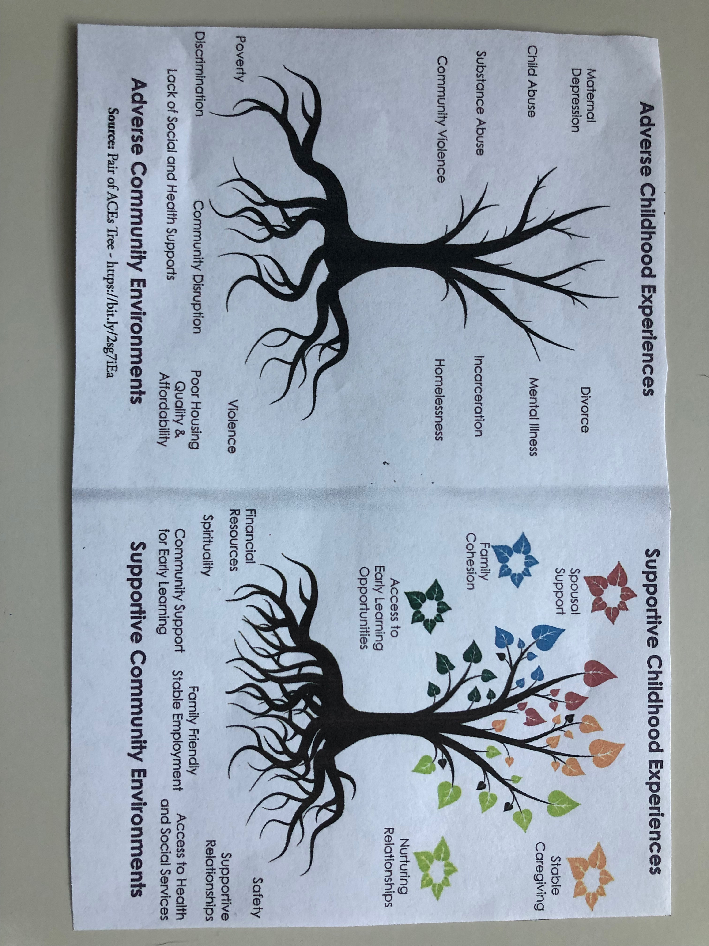

Slide 5
Harvard Center for the Developing Child: Building Adult capabilities to improve Child Outcomes
https://www.youtube.com/watch?v=urU-a_FsS5Y

Slide 8
What can we Do?
Prevent
Foster resilience and build capabilities
Establish relationships with children, families, and partners
REALITY CHECK: Does our practice and policy manifest these? What barriers exist? What are we doing that promotes and impedes these growth factors for families?

Slide 9
Supporting Networks for Families
Preschool and Child Care
School District
Other Organizations
Anacortes Families
Churches
Local Business
Hospital
City
Service Clubs
Notes:
All of these agencies work to support families. Which are you connected with and how can you work with and through those organizations to improve and increase access and support? Examine what you currently do to build capabilities. Ask what can we do better? Example: Kiwanis Preschool scholarships—child is getting access to education and ability to work, parenting classes, Kaleidoscope Play and Learn, your club partnering with other clubs to address child care needs in town. Continue to do good work. Let it spill over into your other organizations, inspire others. In what other ways can you expand, build, give, and serve?

Slide 10
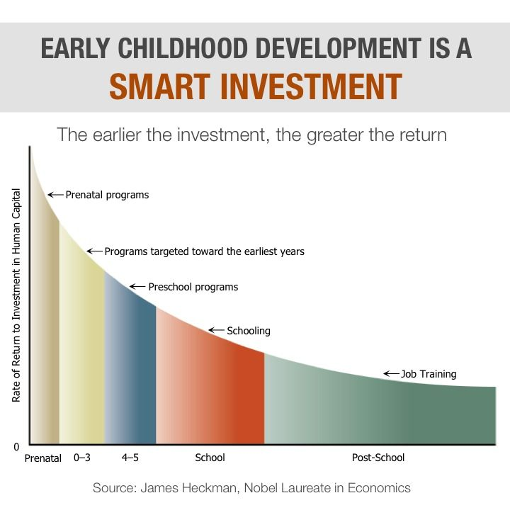

Slide 11
Early Learning Programs and Services- Anacortes Early Learning Coordinator
Service or Material | Who and how many is served? | Frequency | Annual Cost to Offer Service/Material | Partners/ Funding | Cost to Participant/ Recipient | Evidence Based Practice?
Preschool/ Childcare Scholarships | 5-15 kids per semester | Five payments per semester, per child | Up to $250 per month, per child | Local service organizations, business, and individual donors. Anacortes Schools Foundation | Free. May still need to pay for remaining cost due for tuition | Attending preschool-Yes
Parenting Classes With Free Child Care | Parents of children ages 0-8 yrs. Up to 20 parents per class, up to 120 annually. | 6-10 classes a year | Approximately$1,200-$1,600 (due after reg fees collected and deducted from total operating cost) | Local service organization, hospital, and United Way of Skagit | $0-5 a class per person | Yes
Kaleidoscope Play and Learn Groups | Parents and children ages 0-5.Participants will vary from week to week. Up to 100 families served. | 22 meetings this academic year | $1,800 for facilitator per year, up to $400 in materials, as needed. $1,000 per year for affiliated license fee. | Local service organization | Free | Yes
Purchase Enrichment Materials (available for loan from ASD) | Preschool and child care providers, K-1st teachers, and families of young children (as utilized) | As needed | $500-$1,000 | Local service organizations | Free | Yes- all materials are selected based on reviewed effectiveness
Professional Development For Anacortes Early Learning Partners (AELP) | Prof dev/training sessions plus partial scholarships for registration fees for preschool/child care providers to attend prof. conferences and/or weekend trainings (30-45 people annually) | 10-15 prof dev sessions sponsored by ASD, 2-3 prof conferences in area a year | $300-$500 | Local individual donors and service organizations | ASD sponsored prof dev is free to AELPs. Portion of conference reg. fee can be covered by funds with approved ASD sponsored scholarship. | Yes

Slide 12
Reach Out and Read | Partner with local family practice doctor to give a book to every child, every doctor visit | Approximately 1,900 books a year distributed | $3,400 a year | Local partnering physician, Island Hospital Foundation,and local service organizations | Free | Yes
Literacy Begins at Birth Program | Every baby born at Island Hospital receives a handmade blanket, a new book, a healthy baby development pamphlet, and info on why reading to infant is important-all in a reusable bag. | Approximately 400 babies a year | $1,700-2,300 a year | Island Hospital Foundation, local quilters, local service organization, hospital | Free | Yes, info re: early literacy & development, plus increased access to print
Preschool Behavioral Specialist | As needed, up to $700 per site, per year | Varies | $8,000 total available | Local business and Anacortes Schools Foundation | Free | Yes
Expanded Summer Learning (enrollment & planning through June) | Entering Kinders 12 kids- 2016, 3hrs 30 kids- 2017, 4.5hrs 40 kids-2018, 4.5 hrs | 3- 4 weeks in summer | $8,000 $11,500 $23,000 | District and local, private donors | Free | Yes

Slide 13
Other Early Learning Programs and Services
outreach efforts to build an informed community (such film screenings with panel discussions and presentations on EL and ACES)
applying for grants and securing funding
Family Fun Day (STEM)
preschool placement assistance
resource sharing with families (WIC, health, diapers, food, housing, safety, college scholarships, etc)

Slide 14
Resource Mapping: What Will you DO Now?
Howdy Partner (Identify &connect)
hook ‘em (appeal/inspire)
hatch a plan (conspire)
-Hospital
-You serve families, we serve families! You used to have parenting classes, now you don’t. Why not? Tell me more.
-Let’s offer parenting classes together! What resources can you offer? I’ve got space and connections to specialists.

Slide 15
Go Ahead; Be Judgmental!
Is it transactional or transformative? Seek to offer programs and services that truly LIFT our families.
Book
Book + Lunch
Book + Lunch + Place to Eat
Book + Lunch + Place to Eat + Deliberate Exposure to Functional Practices

